Slide 1
(on Dev) Probability

Slide 2



Why probability matters in ML/DS ? Data is uncertain, models make predictions with uncertainty. Probability helps us understand how uncertain we are in our prediction
Examples: Spam detection, weather prediction, classification probabilities.
Basic Terms
Sample space (Ω): All possible outcomes. Let’s see few examples.
1 Coin toss → Ω = {H, T}
Roll a dice -> Ω = {1, 2, 3, 4, 5, 6}
2 coin toss -> Ω = {HH, HT, TH, TT}
3 coin toss -> Ω = { HHH, HHT, HTT, …, TTT} . There would be total of 8 elements
In drawing a card -> Ω = 52 outcomes or elements
Events (E): Subsets of the sample space Ω
e.g.1 In 2 coin toss, event could be same outcome in both toss, {HH, TT}
e.g.2 In dice roll, event could be the even number on dice { 2, 4, 6}
e.g.3 Pick a card, event could be that card is ace, {Ace of heart, Ace of diamond, Ace of clubs, Ace of Spades}
Probability of an event (P(E)): Number of favorable outcomes / Total outcomes (for equally likely events).
Quick Example:
Toss 2 coins: P(both heads)?
Event is both toss are heads.
Ω = {HH, HT, TH, TT}
P(HH) = 1/4.
Draw a card: What’s P(card is red) ?
Here event is card is red.
P(card is red ) = 26/52 = 1/2

Slide 3
Examples of probability (ML perspective)
E.g.. Given below historical data of the emails that you received in 7 days, what is the prob that a new email is spam ?
Ans: P(Y) = 4/7
e.g.: Lets say that you roll a dice. Following are 2 events.
Event A: number is multiple of 2
Event B: number is multiple of 3
Calculate following: P(A), P(B), P(A AND B) P(A OR B)
Solutions:
Here sample space Ω = {1,2,3,4,5,6}
A = {2, 4, 6}
B = {3, 6}
P(A) = 3/6 = 1/2 = 0.5
P(B) = 2/6 = 1/3 = 0.33
P(A AND B) = P(A ∩ B)= 1/6. The favorable outcome is {6}
P(A OR B) = P(A ∪ B) = 4/6. The favorable outcome are {2,3,4,6}
email | Is_spam
E1 | Y
E2 | Y
E3 | Y
E4 | N
E5 | N
E6 | Y
E7 | N
E | ?

Slide 4
Examples of probability (ML perspective)
E.g.: If a product has been rated by customers by some ratings
5-star → 40 times
4-star → 35 times
3-star → 15 times
2-star → 10 times
1-star → 1 times
If a rating is randomly chosen, what is the probability that it is 4-star or higher?
Solution:
Here sample space Ω = all ratings. The size of sample space = 40 + 35 + 15 + 10 + 1 = 101
Here event E is randomly chosen rating is 4-star or 5-star. Size of E is 35 + 40 = 75
P(E) = 75/101 = 0.75

Slide 5
Probability (p2)
Rules of Probability
Complement rule: P(not A) = 1 – P(A)
e.g.1: If P(rain) = 0.7, then P(no rain)= 1 – 0.7 = 0.3
e.g.2: Draw a card: P(Ace) = 4/52 and P(not Ace) = 1 – 4/52
e.g.3: Suppose based on past email data we know that
P(any email is spam) = 323/1000 = .323
Then P(any email is non-spam) = 1 – .323 = .977
(NOTE: It does NOT mean that P(A | E) + P(A | not E) is 1.)
Addition rule: P(A ∪ B) = P(A) + P(B) – P(A ∩ B)
e.g.1 Suppose you draw a card and
Event A: card is ace
Event B: card is red
What is P (A or B)? i.e. what is the probability that card is ace or red
Solution:
P(A or B)
= P (A U B)
= P(A) + P(B) – P(A ∩ B)
= 4/52 + 26/52 – 2/52
= 28/52

Slide 6
Probability (p2)
e.g2 Suppose you’re designing a fraud detection system for online transactions.
Based on past historical data of 10,000 transactions, we have following empirical results.
Event A: Transaction is large (over $5,000). 1000 transaction were > $5000. So, P(A)=0.10
Event B: Transaction is from an unusual location. 500 transaction were from unusual locations. So, P(B)=0.05
Event A ∩ B: 200 transactions were large and from an unusual location → P(A∩B) = 0.02
Question: Suppose you receive some transaction. What is the probability that transaction is either large OR from an unusual location?
Answer : P(A ∪ B)
= P(A) + P(B) – P(A ∩ B)
= 0.10 + 0.05 − 0.02
= 0.13.
e.g3 Suppose you’re designing a recommendation system
Based on past historical data we have calculated
Event A: 10 % user likes sci-fi → P(A)=0.10
Event B: 5% user likes fantasy → P(B)=0.05
Event A ∩ B: 2% user likes sci-fi and fantasy → P(A∩B)=0.02
Question: Suppose you pick a user. What is the probability that user likes sci-fi OR fantasy?
Answer: P(A ∪ B)
= P(A) + P(B) – P(A ∩ B)
= 0.10 + 0.05 − 0.02
= 0.13.

Slide 7



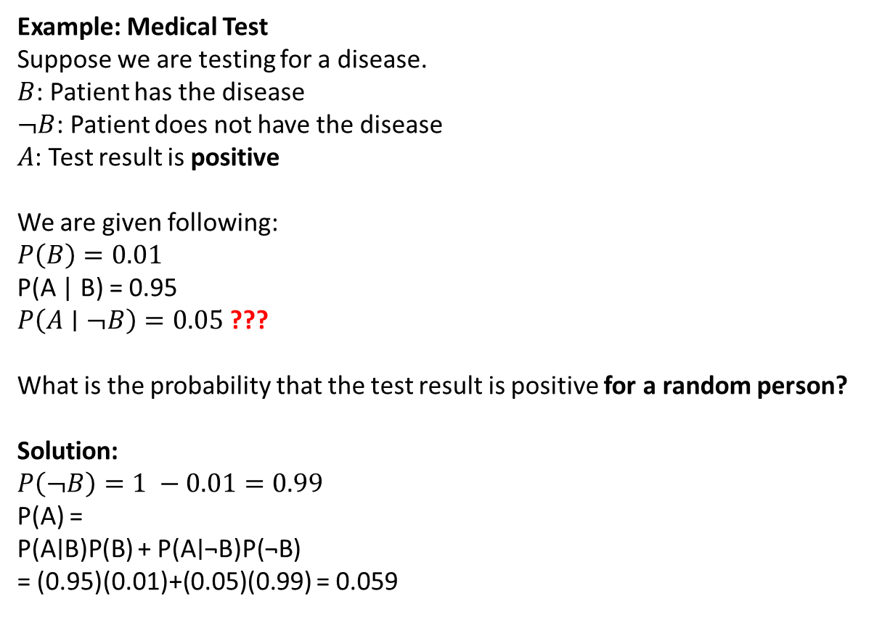


Law of total probability: Simple case
P(B) = P(B | A) * P(A) + P(B | not-A) * P(not-A)
The probability of $B$ is the weighted average of$B$ happening when $A$ happens, and when $A$ does not happen.
Example: Medical Test
Suppose we are testing for a disease.
$B$: Patient has the disease
$¬B$: Patient does not have the disease
$A$: Test result is positive
We are given following:
$P\left(B\right)=0.01$
P(A | B) = 0.95
$P\left(A∣¬B\right)=0.05$ ???
What is the probability that the test result is positive for a random person?
Solution:
$P\left(¬B\right)=1 −0.01=0.99$
P(A) =
P(A∣B)P(B) + P(A∣¬B)P(¬B)
= (0.95)(0.01)+(0.05)(0.99) = 0.059

Slide 8
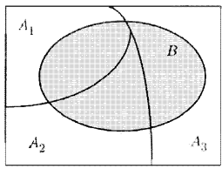
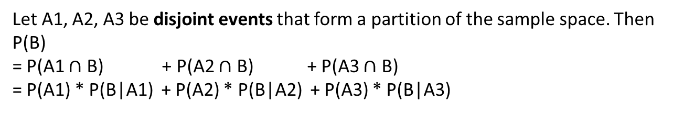
Total Probability Theorem: General case
Let A1, A2, A3 be disjoint events that form a partition of the sample space. Then
P(B)
= P(A1 $∩$ B) + P(A2 $∩$ B) + P(A3 $∩$ B)
= P(A1) * P(B|A1) + P(A2) * P(B|A2) + P(A3) * P(B|A3)
Example: Suppose based on historical data we know following:
1) 40% of all emails are spam: P(Spam) = 0.4
2) The word “Discount” appears in 70% of spam emails: P(“Discount” | Spam) = 0.7
3) The word “Discount” appears in 1% of non-spam emails: P(“Discount” | Not Spam) = 0.01
Question1: What is the probability that word ‘discount’ is present in new email?
Answer1 : Here,
A1 = email is spam
A2 = email is non-spam
B = ‘Discount’ is present in email
So, P(B) = P(‘Discount’)
= P(Spam) × P(“Discount” ∣Spam) + P(Not Spam) × P(“Discount” ∣ Not Spam)
= (0.4×0.7)+(0.6×0.01) = 0.28+0.006 = 0.286.
Question2: If the new email has the word “Discount”, what is prob that it is spam ?
Answer2: P(Spam∣“Discount”) = P(“Discount”∣Spam)×P(Spam) / P(“Discount”)
= (0.7 * 0.4) / 0.286 = 0.979
(This is Bayes’ Theorem in action.)

Slide 9
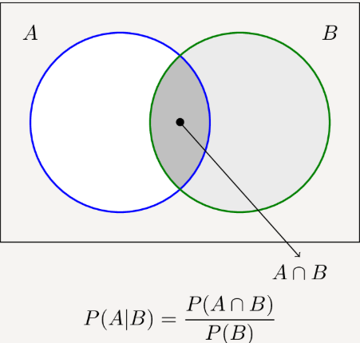
Examples of probability: Conditional probability
P(A | E)
Rolling dice:
A) If you roll a standard six-sided die, what is the probability of rolling a 6?
Ans: Ω = {1, 2, 3, 4, 5, 6}
A is the event that you got 6. A = {6}
P(A) = 1/6
B)If you roll a standard six-sided die, what is the probability of rolling a 6, given that the result was a number greater than 3?
Ans:
A is an event where you get 6: A = {6}
E is an event where the roll was greater than 3: i.e. E = { 4, 5, 6 }
A ∩ E = {6}
Here, P(A ∩ E) = 1/6
And P(E) = 3/6 = 1/2
P( A | E ) = (1/6) / (1/2) = 1/3
The original probability of rolling a 6 is 1/6. Knowing the roll was greater than 3 (i.e., 4, 5, or 6) changes the possible outcomes, and therefore the probability. The new probability is 1/3 (one favorable outcome out of three possibilities).

Slide 10
Probability (p2)
Conditional probability: P(A|B) = P(A ∩ B) / P(B)
e.g. Markov Models (NLP)
Suppose you’re building a language model.
A: The next word is “dog”
B: The previous word is “big”
A Markov model says:
P(A | B) =
P(“dog”∣“big”)= P(“big dog”)/ P(“big”)
​
So:
If 2% of all word pairs are “big dog” → P(A∩B)=0.02
And 5% of all word pairs start with “big” → P(B)=0.05
Then:
P(“dog”∣“big”)=0.02 / 0.05 = 0.4.
So there’s a 40% chance that “dog” follows “big”.
This is how N-gram models work for text prediction.
Problem:
Suppose you draw a card. What is the probability that the card is Ace ?
Here sample space Ω = all possible 52 outcomes.
Event A: Card is Ace
P(A) = 4/52 = 1/13
B) Suppose you draw a card. What is the probability that the card is Ace, given that card is Red ?
Sample space Ω = all possible 52 outcomes.
Event A: Card is Ace
Event B: Card is red (26 cards are red)
Here I have to find out P(A|B).
A ∩ B = {Ace of hearts, Ace of diamonds}
P(A ∩ B) = 2/52
P(B) = 26/52
So,
P(A|B)
= P(A ∩ B) / P(B)
= (2/52) / (26/52) = 1/13
Additional piece of information did not change the probability.

Slide 11
Probability (p2)
e.g.: Medical Diagnosis (Bayesian Networks)
Suppose you’re building a disease prediction model.
A: Patient has the disease
B: Patient has a positive test result
Suppose based on past data we have,
P(A∩B)=0.0095 (0.95% of the population both have the disease and test positive)
P(B)=0.05 (5% of all tested people test positive)
Then:
P(A∣B)= P(A∩B)/ P(B) = 0.0095/0.05 = 0.19.
So, if a patient tests positive, there’s a 19% chance they really have the disease.
This is the Bayesian update idea in medical AI.

Slide 12
Probability (p2)
Multiplication rule: P(A ∩ B) = P(A) × P(B|A)
3) Example
Event A: It rains tomorrow (30% chance). Event B: You drive car to work , and not scooter (5% chance).
Are these independent? No!. B is dependent on A: If it rains, then it's very likely that you will take car to work.
So, P(A ∩ B) = P(A) × P(B) is not applicable here
1) Classic Everyday Example
Scenario: You flip a coin and roll a die.
Event A: The coin lands Heads
Event B: The die shows a 6
Are they independent? Yes
Yes! The outcome of the coin does not affect the die.
P(Heads and 6)
= 1/2 * 1/6 ≈0.083.
4) Example : Balls in an Urn — Without Replacement
Scenario:
An urn has 3 red balls and 2 blue balls.
You draw two balls one after the other without replacement.
Event A: The first ball is red.
Event B: The second ball is red.
Are these independent? No! The first draw affects the second — the total number of red balls left changes.
Here P(A) = 3/5
P(B) = does not make sense, instead P(B|A) = 2/4 makes sense
2) Example
Event A: It rains tomorrow with 30% chance Event B: You win a random lucky draw with 5% chance.
Are they independent? Yes — rain doesn’t affect the draw.
P(Rain and Win)
=P(Rain)×P(Win)
=0.3×0.05
=0.015.

Slide 13
Application of probability in AI ML (p1)
Probability in Generative Models — Text Generation
Example: In GPT models: P(next word ∣ previous words)
If you write: “The cat sat on the” The model might compute:
P(next word=mat| previous words are “The cat sat on the” ) = 0.6
P(next word=floor| previous words are “The cat sat on the”) = 0.2
P(next word=roof| previous words are “The cat sat on the”) = 0.05
It samples words based on these probabilities to generate realistic text.
Probability in Clustering — Gaussian Mixture Models (GMM)
Example: When clustering customers, a GMM says:
Each cluster is a probability distribution (usually Gaussian).
Each point belongs to each cluster with some probability.
So, customer A might belong:
70% to Cluster 1 (young students)
30% to Cluster 2 (young professionals)
Unlike K-Means, GMM gives soft assignments.

Slide 14
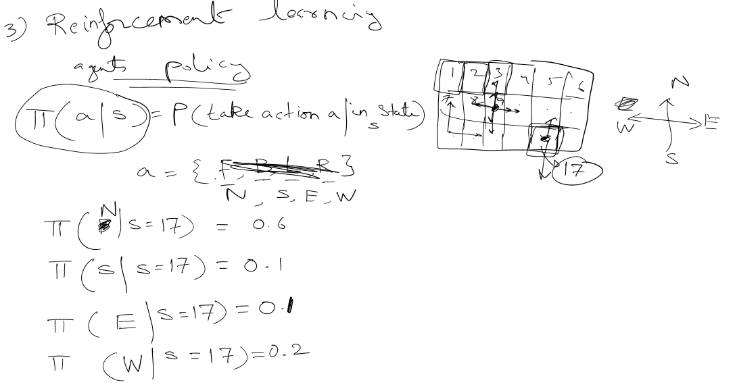
Application of probability in AI ML (p2)
In RL, like training robots, the agent's policy is
PI(a|s) = Prob(take action a | in state s)
The policy samples actions probabilistically- helping agents to explore

